Slide 1



MPIG Open Seminar 0117
Recommender Systems
陈洪云
Machine Perception and Interaction Group (MPIG)
www.mpig.com.cn
chy@mpig.com.cn
公众号:
mpig_robot

Slide 2
Example: Predicting movie ratings
User rates movies using one to five stars
Movie | Alice (1) | Bob (2) | Carol (3) | Dave (4)
Love at last
Romance forever
Cute puppies of love
Nonstop car chases
Swords vs. karate

Slide 3
Example: Predicting movie ratings
User rates movies using one to five stars
Movie | Alice (1) | Bob (2) | Carol (3) | Dave (4)
Love at last | 5 | 5 | 0 | 0
Romance forever | 5 | 4 | ？ | 0
Cute puppies of love | ? | ？ | 0 | ？
Nonstop car chases | 0 | 0 | 5 | 4
Swords vs. karate | 0 | 0 | 5 | ？

Slide 4





Example: Predicting movie ratings
User rates movies using one to five stars
Movie | Alice (1) | Bob (2) | Carol (3) | Dave (4)
Love at last | 5 | 5 | 0 | 0
Romance forever | 5 | 4 | ？ | 0
Cute puppies of love | ? | ？ | 0 | ？
Nonstop car chases | 0 | 0 | 5 | 4
Swords vs. karate | 0 | 0 | 5 | ？
= no. users
= no. movies
= 1 if user has rated movie
= rating given by user to movie (defined only if
)

Slide 5
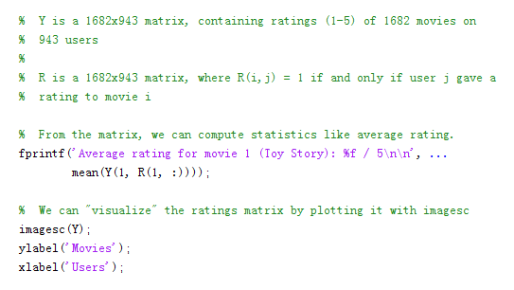
P64

Slide 7
Content-based recommendations

Slide 8


Content-based recommender systems
Movie | Alice (1) | Bob (2) | Carol (3) | Dave (4) | (romance) | (action)
Love at last | 5 | 5 | 0 | 0 | 0.9 | 0
Romance forever | 5 | ? | ? | 0 | 1.0 | 0.01
Cute puppies of love | ? | 4 | 0 | ? | 0.99 | 0
Nonstop car chases | 0 | 0 | 5 | 4 | 0.1 | 1.0
Swords vs. karate | 0 | 0 | 5 | ? | 0 | 0.9
Notes:
Add dots

Slide 9
Content-based recommender systems
×1
×2
Movie | Alice (1) | Bob (2) | Carol (3) | Dave (4) | (romance) | (action)
Love at last | 5 | 5 | 0 | 0 | 0.9 | 0
Romance forever | 5 | ? | ? | 0 | 1.0 | 0.01
Cute puppies of love | ? | 4 | 0 | ? | 0.99 | 0
Nonstop car chases | 0 | 0 | 5 | 4 | 0.1 | 1.0
Swords vs. karate | 0 | 0 | 5 | ? | 0 | 0.9

Slide 10




Content-based recommender systems
×1
×2
Movie | Alice (1) | Bob (2) | Carol (3) | Dave (4) | (romance) | (action)
Love at last | 5 | 5 | 0 | 0 | 0.9 | 0
Romance forever | 5 | ? | ? | 0 | 1.0 | 0.01
Cute puppies of love | ? | 4 | 0 | ? | 0.99 | 0
Nonstop car chases | 0 | 0 | 5 | 4 | 0.1 | 1.0
Swords vs. karate | 0 | 0 | 5 | ? | 0 | 0.9
For each user ,learn a parameter .Predict user as rating movie with stars.

Slide 11






Problem formulation
if user has rated movie (0 otherwise)
rating by user on movie (if defined)
= parameter vector for user
= feature vector for movie
For user , movie , predicted rating:
= no. of movies rated by user
To learn :

Slide 12
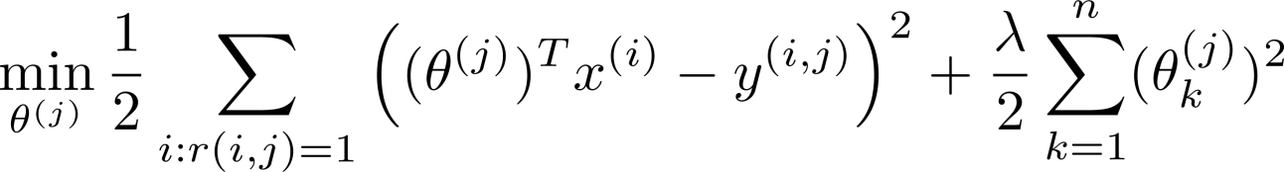
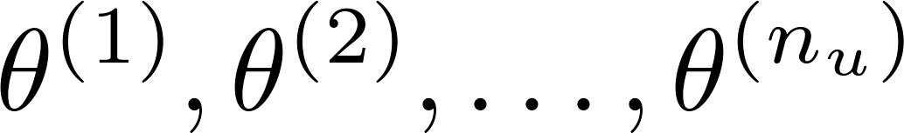
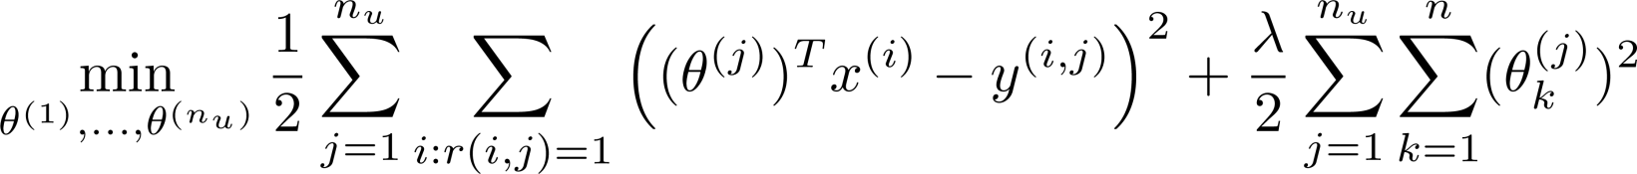
Optimization objective:
To learn (parameter for user ):
To learn :

Slide 13
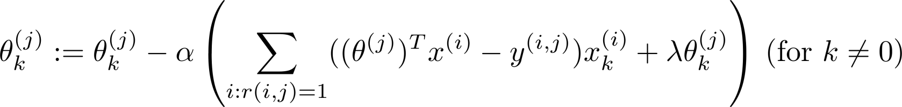
Optimization algorithm:
Gradient descent update:

Slide 14
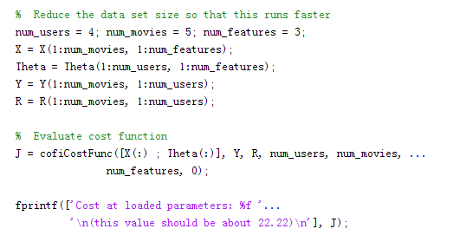
P64

Slide 15
J=J+sum(sum((R.*(X*Theta'-Y).^2)))/2+lambda/2*sum(sum(Theta.^2))+...
lambda/2*sum(sum(X.^2));
for i=1:size(X,1)
idx = find(R(i,:)==1);
Thetatemp = Theta(idx,:);
Ytemp = Y(i,idx);
X_grad(i,:)=(X(i,:)*Thetatemp'-Ytemp)*Thetatemp+lambda*X(i,:);
end
for j=1:size(Theta,1)
idx = find(R(:,j)==1);
Xtemp = X(idx,:);
Ytemp = Y(idx,j);
Theta_grad(j,:)=(Xtemp*Theta(j,:)'-Ytemp)'*Xtemp+lambda*Theta(j,:);
end
P64

Slide 16
Collaborative filtering

Slide 17
Problem motivation
Movie | Alice (1) | Bob (2) | Carol (3) | Dave (4) | (romance) | (action)
Love at last | 5 | 5 | 0 | 0 | 0.9 | 0
Romance forever | 5 | ? | ? | 0 | 1.0 | 0.01
Cute puppies of love | ? | 4 | 0 | ? | 0.99 | 0
Nonstop car chases | 0 | 0 | 5 | 4 | 0.1 | 1.0
Swords vs. karate | 0 | 0 | 5 | ? | 0 | 0.9
Notes:
Change numbers to LATEX as well

Slide 18
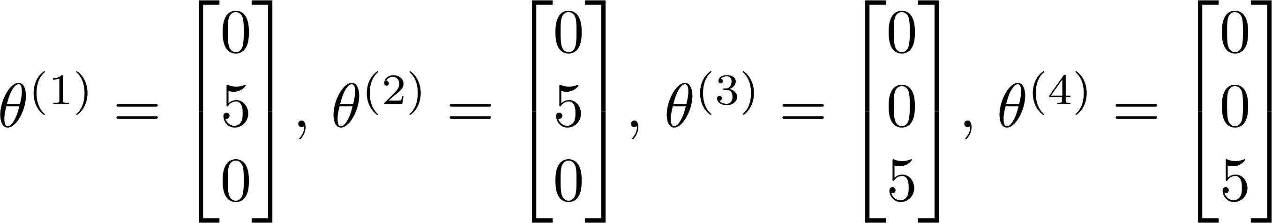
Problem motivation
Movie | Alice (1) | Bob (2) | Carol (3) | Dave (4) | (romance) | (action)
Love at last | 5 | 5 | 0 | 0 | ? | ?
Romance forever | 5 | ? | ? | 0 | ? | ?
Cute puppies of love | ? | 4 | 0 | ? | ? | ?
Nonstop car chases | 0 | 0 | 5 | 4 | ? | ?
Swords vs. karate | 0 | 0 | 5 | ? | ? | ?
Notes:
Change numbers to LATEX as well

Slide 19
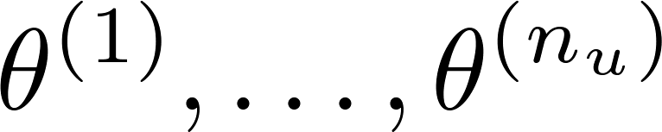

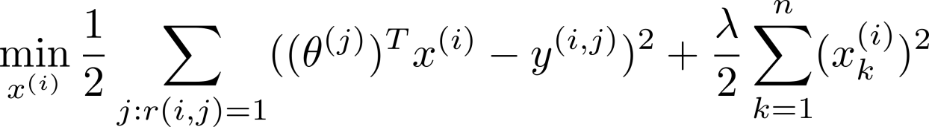
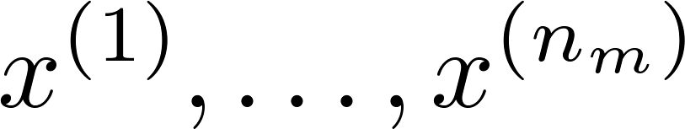
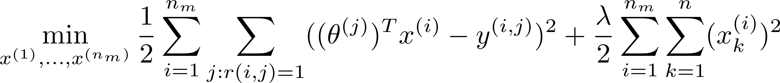
Optimization algorithm
Given , to learn :
Given , to learn :

Slide 20
Collaborative filtering algorithm

Slide 21
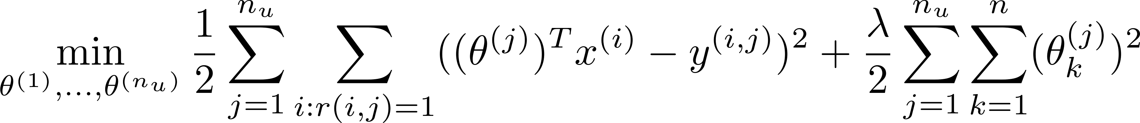

Collaborative filtering optimization objective
Given , estimate :
Given , estimate :
Minimizing and simultaneously:

Slide 22
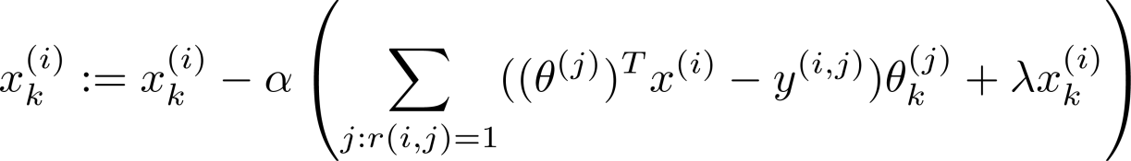
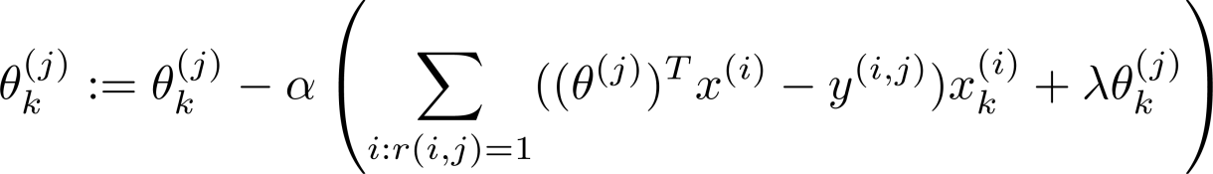

Collaborative filtering algorithm
Initialize to small random values.
Minimize using gradient descent (or an advanced optimization algorithm). E.g. for every :
For a user with parameters and a movie with (learned) features , predict a star rating of .

Slide 23
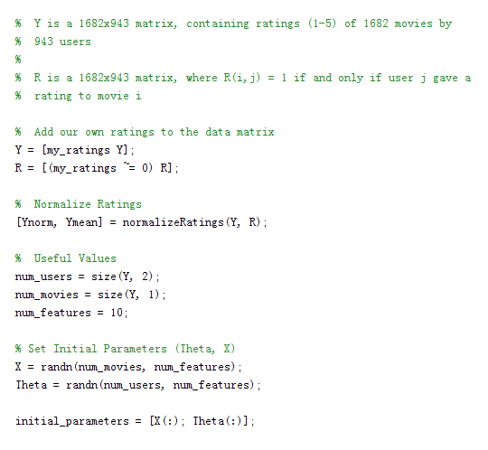
P64

Slide 24
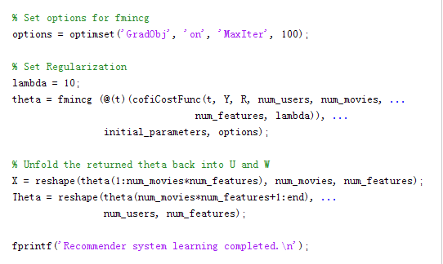
P64

Slide 25
Vectorization: Low rank matrix factorization

Slide 26
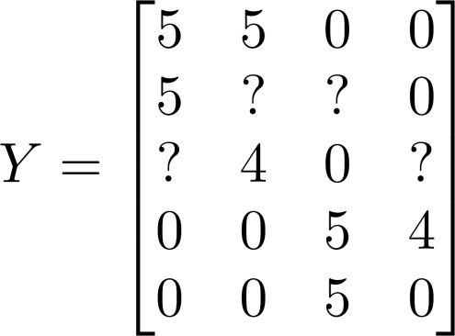
Collaborative filtering
Movie | Alice (1) | Bob (2) | Carol (3) | Dave (4)
Love at last | 5 | 5 | 0 | 0
Romance forever | 5 | ? | ? | 0
Cute puppies of love | ? | 4 | 0 | ?
Nonstop car chases | 0 | 0 | 5 | 4
Swords vs. karate | 0 | 0 | 5 | ?
Notes:
Make points have 0 mean on x1 and x2

Slide 27
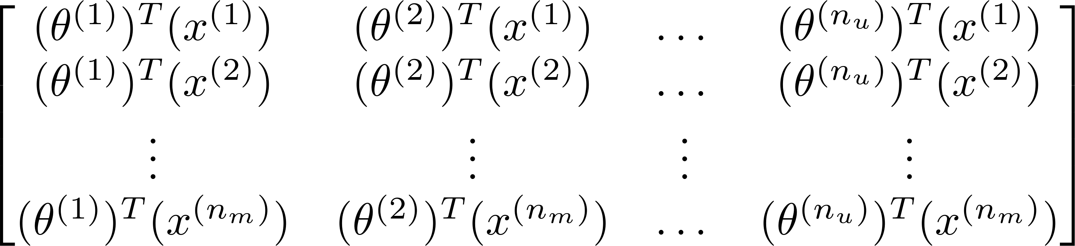
Collaborative filtering
Predicted ratings:
Notes:
Make points have 0 mean on x1 and x2

Slide 28
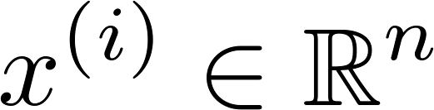

Finding related movies
For each product , we learn a feature vector .
How to find movies related to movie ?
5 most similar movies to movie :
Find the 5 movies with the smallest .
Notes:
Make points have 0 mean on x1 and x2

Slide 29
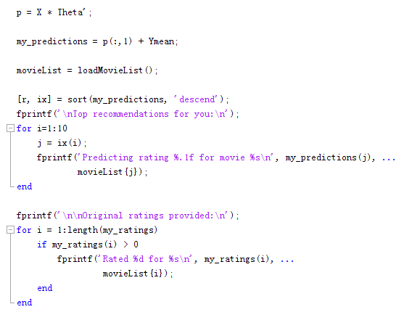
P64

Slide 30
Implementational detail: Mean normalization

Slide 31
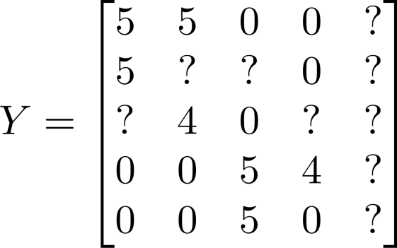

Users who have not rated any movies
Movie | Alice (1) | Bob (2) | Carol (3) | Dave (4) | Eve (5)
Love at last | 5 | 5 | 0 | 0 | ?
Romance forever | 5 | ? | ? | 0 | ?
Cute puppies of love | ? | 4 | 0 | ? | ?
Nonstop car chases | 0 | 0 | 5 | 4 | ?
Swords vs. karate | 0 | 0 | 5 | ? | ?

Slide 32
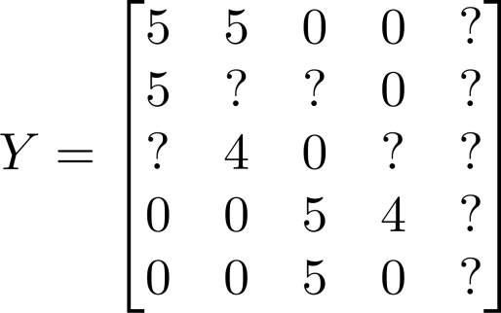
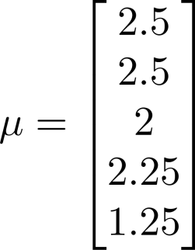
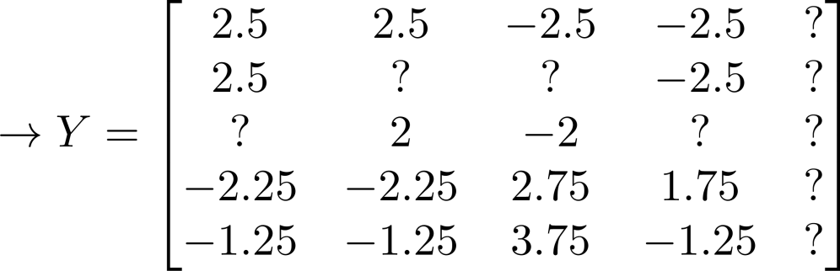

Mean Normalization:
For user , on movie predict:
User 5 (Eve):

Slide 33
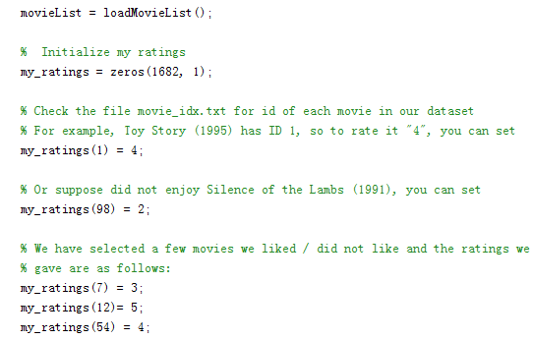
P64

Slide 34
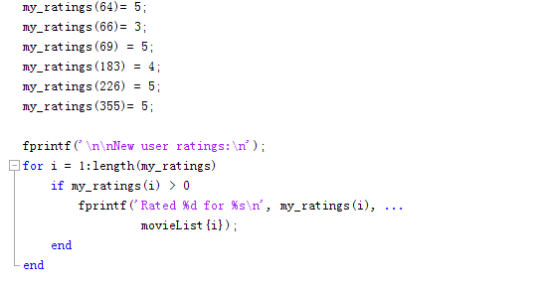
P64

Slide 35
Thanks
Machine Perception and Interaction Group (MPIG)
www.mpig.com.cn
chy@mpig.com.cn
公众号:
mpig_robot

